Slide 1
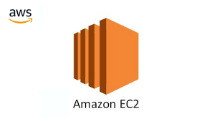
Continues………

Slide 2
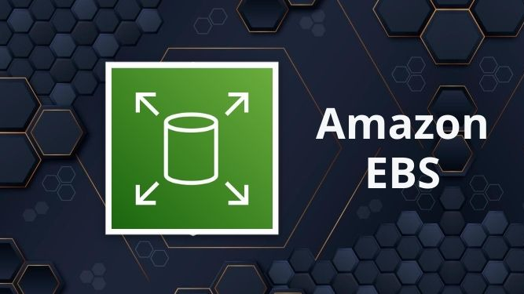

Slide 3

Think of EBS as a virtual hard drive for your Amazon EC2 virtual servers (instances) in the AWS cloud.
It provides persistent block storage, meaning your data remains intact even if you stop or terminate your EC2 instance.
EBS volumes are essential for applications that need reliable, high-performance storage, like databases, file systems, and enterprise software.

Slide 4
Features of EBS
Persistent Storage – Unlike instance store volumes, EBS volumes persist even if the EC2 instance is stopped or terminated.
High Availability & Durability – Data is replicated within an Availability Zone (AZ) to protect against failures.
Scalability – EBS volumes can be resized, and performance can be adjusted without downtime.
Encryption – Supports encryption at rest using AWS Key Management Service (KMS).
Snapshot Support – Users can create snapshots of EBS volumes for backup and disaster recovery.
Performance Optimization – EBS provides multiple volume types to meet different workload needs.

Slide 5

Use Cases of EBS
Databases – Storing relational (MySQL, PostgreSQL) and NoSQL (MongoDB, Cassandra) databases.
Big Data Analytics – Large-scale processing workloads like Hadoop, Spark.
Containerized Applications – Persistent storage for Kubernetes and Docker containers.
Virtual Desktops – Storing OS and user data for remote desktops.
Backup & Disaster Recovery – EBS Snapshots help in restoring data quickly.

Slide 6
EBS Volume Types in Detail
General Purpose SSD (gp2, gp3):
gp2: Offers a balance of price and performance. It provides single-digit millisecond latencies and can burst up to 3,000 IOPS per volume.
gp3: Allows you to provision IOPS and throughput independently, providing more flexibility and cost savings for many workloads.
Provisioned IOPS SSD (io1, io2):
io1: Designed for I/O-intensive applications such as large relational or NoSQL databases. It allows you to provision up to 64,000 IOPS per volume.
io2: Offers higher durability and more IOPS per GB than io1, with up to 64,000 IOPS per volume and 1,000 IOPS per GB.

Slide 7
Throughput Optimized HDD (st1):
Ideal for large, sequential workloads like big data, data warehouses, and log processing. It provides low-cost magnetic storage with high throughput.
Cold HDD (sc1):
Suitable for less frequently accessed workloads, such as cold data storage. It is the lowest-cost HDD option.
Magnetic (standard):
Legacy volume type offering low-cost, magnetic storage. It’s slower and less durable than other volume types, but it's priced very cheaply.
Not recommended for most modern workloads, but can be used for low-cost archival storage or less demanding applications that don’t require fast access to data.

Slide 8
Create the EBS Volume
Attach the EBS Volume to EC2 Instance
Configure the EC2 Instance to Use the Volume
SSH into your EC2 Instance
Check the Attached Volume: #lsblk
Format the Volume (if it's a new volume): #sudo mkfs -t ext4 /dev/xvdf
Create a Mount Point: #sudo mkdir /mnt/myvolume
Mount the Volume: #sudo mount /dev/xvdf /mnt/myvolume
Verify the Mount: #df -h

Slide 9

Elastic Load Balancer
It is a service that automatically distributes incoming traffic across multiple targets, such as EC2 instances, containers, IP addresses, and Lambda functions, to ensure that no single resource is overwhelmed with too much traffic.
How does it work?
Traffic arrives: When someone tries to access your website, their request first goes to the load balancer.
Distribution: The load balancer uses different algorithms (like round-robin, least connections, etc.) to decide which server is best suited to handle the request. It considers factors like server load, availability, and response time.
Request forwarded: The load balancer forwards the request to the chosen server.
Response back: The server processes the request and sends the response back to the user through the load balancer.

Slide 11
Benefits of using a load balancer
1️⃣ Improved Performance & Speed 🚀 – Distributes traffic evenly, reducing delays and improving response times.
2️⃣ High Availability & Reliability 💡 – Ensures your application is always accessible by rerouting traffic if a server goes down.
3️⃣ Scalability 📈 – Handles increasing traffic by dynamically adjusting to demand.
4️⃣ Security & DDoS Protection 🔒 – Protects against cyberattacks by filtering and managing traffic intelligently.
5️⃣ Efficient Resource Utilization ⚙️ – Maximizes server efficiency by balancing the workload, preventing overload.
6️⃣ Seamless Maintenance 🛠️ – Allows updates and repairs without downtime by redirecting traffic to healthy servers.
7️⃣ Better User Experience 😊 – Ensures smooth performance, making users happy with fast and reliable service!

Slide 12
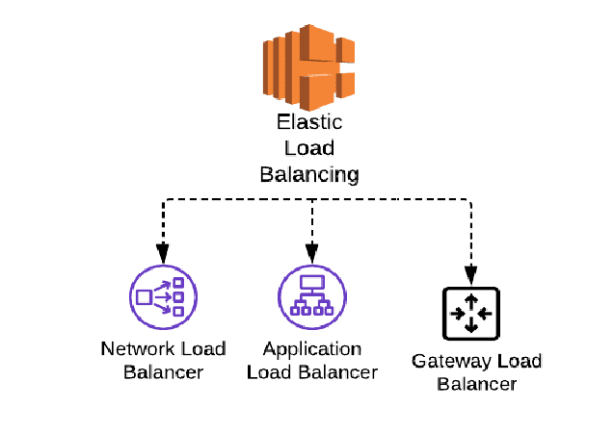
Types of load balancer
Application load balancer
Network load balancer
Gateway load balancer
Classic load balancer (legacy load balancer)

Slide 13
Classic Load Balancer (CLB) 🐣📜
The legacy load balancer that operates at both Layer 4 (TCP) and Layer 7 (HTTP/HTTPS). It’s the oldest type of ELB.
Best for Simple applications or if you’re still using EC2-Classic (though this is mostly deprecated now). 🏚️
Features:
Basic load balancing for HTTP/HTTPS and TCP traffic. 🚦
Supports sticky sessions (session affinity).
Less flexible compared to ALB and NLB. 🐌
CLB is like an old-school traffic cop 🚦 who directs traffic but doesn’t have the fancy tools of modern traffic systems. �👮‍♂️

Slide 14
Application Load Balancer (ALB) 🎯🌐
Operates at the application layer (Layer 7) of the OSI model. It routes traffic based on advanced request data like HTTP/HTTPS headers, paths, or hostnames.
Best for Modern web applications using microservices or container-based architectures (e.g., ECS, EKS, or Lambda). 🐋📦
Features:
Supports path-based routing (e.g., /api to one group, /images to another). 🛤️
Host-based routing (e.g., blog.example.com vs app.example.com). �
WebSockets and HTTP/2 support. 🕸️🚀
Integrates with AWS WAF for security. 🛡️
Think of ALB as a smart post office 🏤 that sorts mail (requests) based on the address (path or hostname) and delivers it to the right mailbox (target group). 📬✨

Slide 15
Network Load Balancer (NLB) 🌐⚡
Operates at the transport layer (Layer 4). It routes traffic based on IP protocol data, such as TCP/UDP traffic.
Best for High-performance, low-latency applications like gaming, IoT, or real-time streaming. 🎮📡
Features:
Handles millions of requests per second with ultra-low latency. 🚀
Supports static IP addresses and Elastic IPs. 🏠📌
Preserves the source IP address of the client. 🕵️‍♂️
Ideal for TCP/UDP-based workloads. 🖧
NLB is like a super-fast highway 🛣️ that ensures your data packets 🚗💨 reach their destination as quickly as possible without any detours! �

Slide 16
Gateway Load Balancer (GWLB) 🚪🔒
Operates at Layer 3 (IP layer) and is designed to deploy, scale, and manage third-party virtual appliances like firewalls, intrusion detection systems, etc.
Best for Security appliances and network traffic inspection. 🛡️🔍
Features:
Uses GENEVE protocol on port 6081. 🖧
Simplifies deployment of virtual appliances across multiple VPCs. �
Scales automatically with traffic. 📈
GWLB is like a bouncer at a club 🕴️ who checks everyone’s ID (inspects traffic) before letting them in (routing to the target). 🎟️🚪

Slide 17
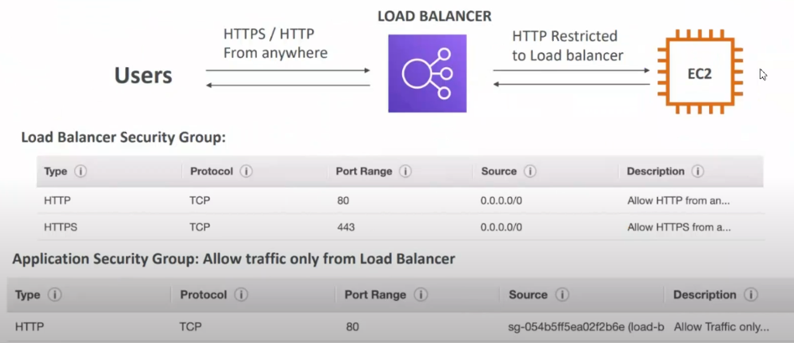
Security group in load balancer

Slide 18

Auto Scaling: is a service that automatically adjusts the number of EC2 instances in your application to ensure optimal performance, availability, and cost efficiency. It helps maintain application availability by scaling out (adding instances) during demand spikes and scaling in (removing instances) during periods of low demand.

Slide 19
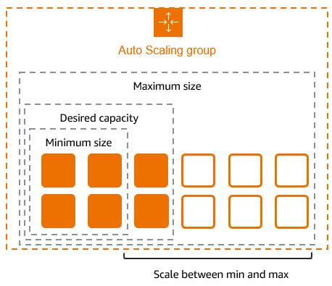
Launch Template or Launch Configuration:
A Launch Template or Launch Configuration defines the configuration for the EC2 instances that Auto Scaling will launch.
It includes details such as the AMI (Amazon Machine Image), instance type, key pair, security groups, and storage.
Scaling Policies:
Scaling policies determine when and how to scale the number of instances in the ASG.

Slide 20
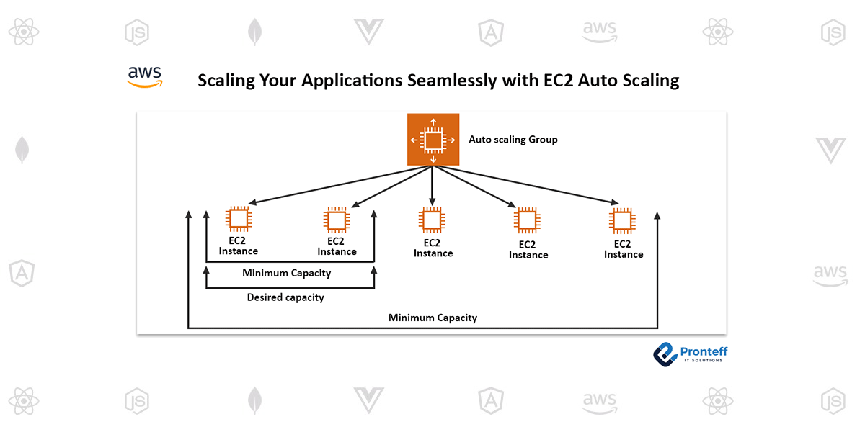

Slide 21

Amazon SNS (Simple Notification Service)
SNS is a fully managed messaging service that enables you to send notifications to multiple subscribers or endpoints. It’s like a postal service 📮 for your applications, delivering messages to the right recipients quickly and reliably!
Amazon SNS is a pub/sub (publish/subscribe) messaging service that allows you to send messages or notifications to multiple subscribers. It supports a variety of messaging formats, including SMS, email, mobile push notifications, and HTTP/HTTPS endpoints. 🌐📨

Slide 22
Features of SNS 🌟
Pub/Sub Messaging: Publishers send messages to topics, and subscribers receive those messages.
Example: A weather app publishes "Rain Alert" to a topic, and all subscribers (e.g., email, SMS, mobile app) receive the alert. 🌧️📢
Multiple Protocols: Supports SMS, email, HTTP/HTTPS, Amazon SQS, mobile push notifications (iOS, Android, etc.), and Lambda functions. 📱💌
Fan-Out Architecture: A single message can be delivered to multiple subscribers simultaneously. 🎉
Example: A news update can be sent to email subscribers, mobile apps, and SQS queues at the same time. 📰📲
Serverless:
Fully managed by AWS—no infrastructure to manage. 🤖

Slide 23
SNS Use Cases 🌐
Application Alerts:
Send alerts for system failures, performance issues, or security breaches. 🚨
Example: Notify DevOps teams via SMS or email when CPU usage exceeds 90%. 📈📲
Mobile Push Notifications:
Send push notifications to iOS, Android, or other mobile devices. 📱
Example: A gaming app sends a notification: "Your friend just beat your high score!" 🎮🏆
Fan-Out to SQS or Lambda:
Use SNS to trigger multiple SQS queues or Lambda functions in parallel. 🚀
Example: A new order triggers updates to inventory, billing, and shipping systems. 📦💳
Broadcasting Messages:
Send messages to a large number of subscribers simultaneously. 📢
Example: A news agency broadcasts breaking news to all subscribers. 📰
Event-Driven Architectures:
Use SNS to decouple microservices and enable event-driven workflows. 🧩
Example: A file upload triggers a Lambda function to process the file and send notifications. 📂🔄

Slide 24

NFS Command in Linux (Network File System):
It is used to mount and manage remote file systems over a network. It allows multiple machines to access the same file system as if it were a local disk.
Amazon Elastic File System (EFS):
It is a scalable, cloud-based file storage service provided by AWS.

Slide 25
Features of EFs:
✅ Scalability: Automatically scales storage capacity up or down as you add or remove files. 📈📉
✅ Shared Storage: Multiple EC2 instances can access the same file system simultaneously. 🤝
Performance Modes:
✅ General Purpose: Ideal for latency-sensitive use cases. ⚡
✅ Max I/O: Optimized for higher throughput and operations per second. 🚀
Throughput Modes:
✅ Bursting Throughput: Suitable for workloads with spiky traffic. 💥
✅ Provisioned Throughput: For applications requiring consistent high throughput. 📊
✅ Durability and Availability: Data is stored redundantly across multiple Availability Zones (AZs) for high durability and availability. 🛡️
✅ Security: Supports encryption at rest and in transit, IAM policies, and VPC security groups.

Slide 26

Use Cases:
Content Management: Shared access to files for web servers. 🌐
Big Data Analytics: Centralized storage for large datasets. 📊
Application Development: Shared storage for development and testing environments. 💻
Backup and Archiving: Reliable storage for backups and long-term archiving. 💾
Pricing:
Pay-as-you-go model based on the amount of data stored. 💰
Additional costs for throughput modes and data transfer. 💸
Setup:
🗂️ Create a File System: Via AWS Management Console 🖥️, CLI or SDK.
🔗 Mount on EC2 Instances: Use NFS protocol to mount the EFS file system on EC2 instances. 🚀

